Slide 1

Raytheon RTX
February 2026
Current Price: 198.09
Target Price: 201.76
Recommendation: Hold
Presented by :
JOE MARFISI

Slide 2
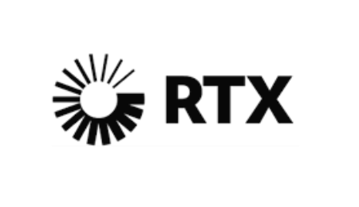
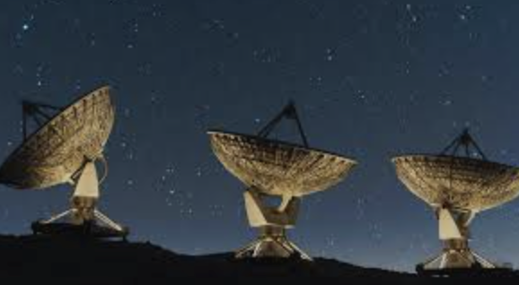
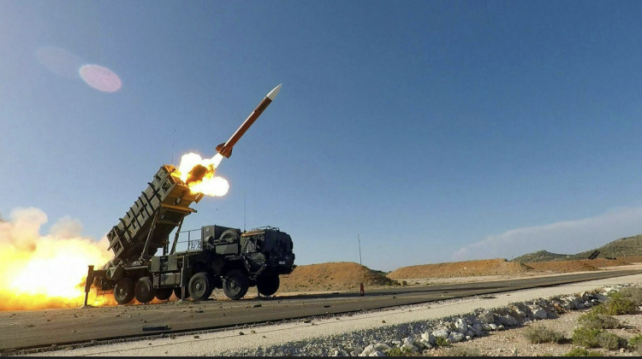
Business Description
Split into 3 sections
Raytheon
Defense segment
Produces Patriot missile defensive systems, advanced radar systems, and Tomahawk Cruise missiles
Pratt & Whitney
Manufacture jet engines: GTF engine and F135 engine
Collins Aerospace
Specialize in Avionic systems – tells pilots where they are and what’s around them
These are found in every plane commercial and military
Notes:
The Company
RTX Corporation — the largest aerospace and defense company in the world with $88.6 billion in revenue
Born from the 2020 merger of United Technologies Corporation and Raytheon Company — two giants combining into one
UTC brought Pratt & Whitney and Collins Aerospace — the commercial aviation powerhouses
Raytheon brought the defense muscle — missiles, radar, and electronic warfare
The result is something no competitor can replicate — equal parts commercial aviation and defense in one company
Raytheon
The pure defense engine of RTX
Makes the weapons the world is buying right now — Patriot missile systems, Tomahawk cruise missiles, NASAMS, advanced radar
Deployed actively in Ukraine, the Middle East, and across NATO Europe
Book to bill ratio of 2.27 — for every dollar shipped, $2.27 in new orders came in
Essentially sold out for years
Pratt & Whitney
Powers the world's most popular commercial jet — the Airbus A320neo
Exclusive engine supplier for every F-35 ever built — no alternatives exist
15,000+ engines in service globally creating decades of locked in aftermarket revenue
Real business model — sell the engine once, collect high margin service revenue for 30 years
Collins Aerospace
The quiet backbone of global aviation
Avionics, landing gear, power systems, cabin interiors — if it's inside an aircraft Collins probably made it
Embedded in virtually every commercial and military platform flying today
Nearly impossible to displace without redesigning the entire aircraft around it
Timeline:

Slide 3
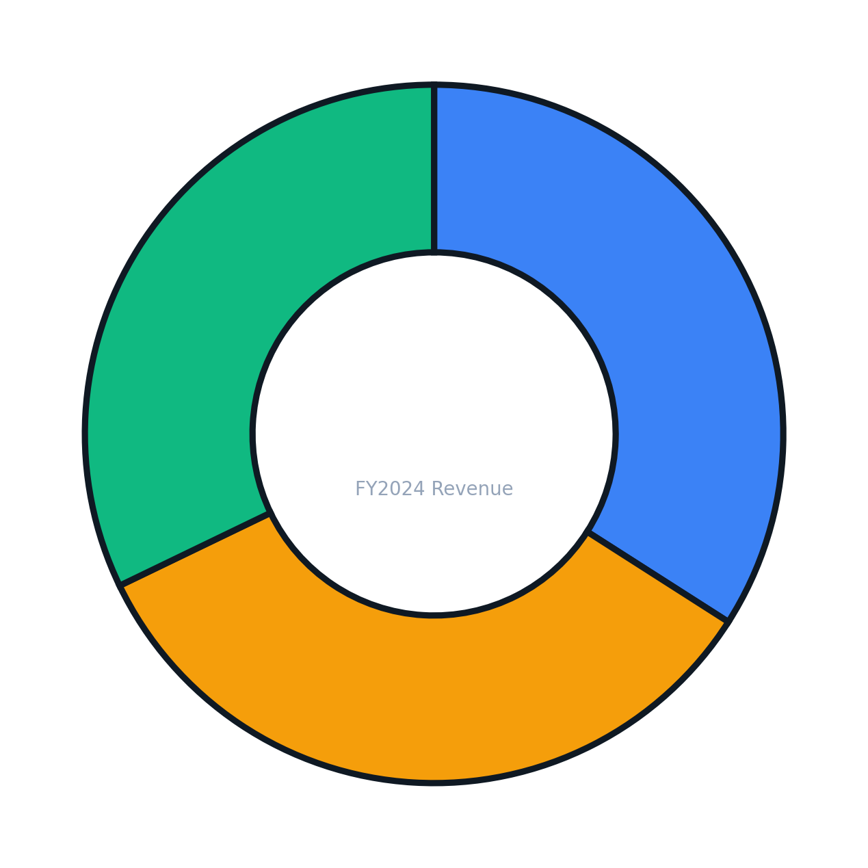
Business Description – Revenue Split
Collins Aerospace
$28.28B
34.0%
Pratt & Whitney
$28.07B
33.8%
Raytheon
$26.71B
32.2%
Notes:
Defense and commercial aviation contracts aren't one-time sales — they're multi-year relationships that generate revenue long after the initial deal is signed
Defense contracts typically run 3 to 7 years — on February 3rd RTX signed a deal with the Pentagon to boost missile production for up to 7 years. In 2025 they secured a Patriot missile defense contract spanning 20 years
RTX and its competitors deliberately bid at razor thin margins just to win the contract — the real profit comes from the years of service, parts, and upgrades that follow. The bid is the door. The aftermarket is the business
This model applies equally to commercial aviation — the FAA requires airlines to maintain their engines on a strict schedule, and performing that maintenance requires certifications that only a handful of companies in the world hold
RTX doesn't just sell airlines an engine — they sell them the only FAA certified blade that fits it. No certification, no alternative, no negotiation on price
15,000+ Pratt & Whitney engines in service globally — each one a locked-in revenue stream feeding parts, maintenance, and overhaul revenue back to RTX for decades
The initial contract is how RTX gets in the door. The next 30 years is how RTX gets paid

Slide 4
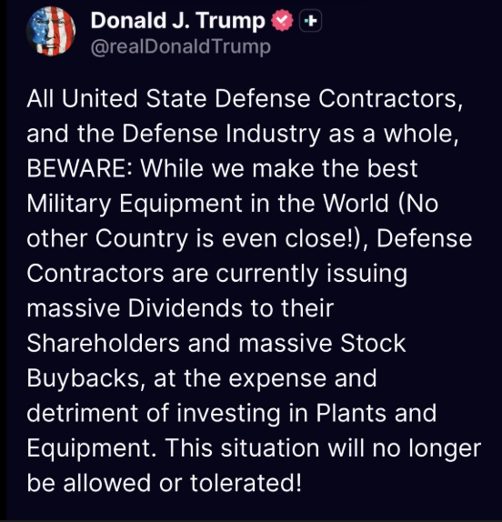
Current News
Geopolitical Climate
Iran/US
Iran passed 200% military budget increase to $46B following domestic unrest
U.S. assembled largest Middle East naval armada since 2003 Iraq invasion
Ukraine/NATO
Patriot missiles (RTX made) are currently being used against Russian ballistic missiles
Defense items donated are legally required to be replenished to NATO
Trump/Global Outlook
Trump proposed $1.5 trillion defense budget for 2027 – largest defense spending proposal in US history
Trump has put pressure on RTX paying out dividends and issuing stock buybacks
Spain just signed $1.7B for four Patriot fire units - December 2025
Notes:
Iran / Middle East
The Middle East is in the early stages of its rearmament cycle — the biggest procurement surge is still ahead
RTX doesn't supply Iran — it supplies everyone watching Iran nervously from next door
The Israel-Palestine conflict involved conventional weapons. A direct confrontation with Iran is a completely different threat level — both sides bring sophisticated missile systems, air defense, and electronic warfare into play
That escalation in sophistication is exactly what drives allied countries to upgrade their own defense capabilities — and RTX is who they call
Trump / Global Outlook
Trump publicly pressured defense companies by name last month — RTX was specifically called out for paying dividends and issuing stock buybacks instead of reinvesting in manufacturing capacity
CEO Chris Calio pushed back — RTX has paid shareholders quarterly for decades and views that commitment as non-negotiable
The silver lining is buried in the criticism — Trump isn't upset because demand is weak. He's upset because demand is so overwhelming that every dollar going to shareholders is a dollar not building more missiles
We are caught directly in this argument — our fund collects the dividends. We benefit from the buybacks through fewer shares outstanding. Institutions like BlackRock and Vanguard benefit most but so do we
The more important story is the neighboring countries — Europe is actively trying to make their defense systems more independent Germany increased defense spending 28% made a 3 billion deal with Raytheon for SM6 and Sm-2 missiles, Poland 31%, and RTX just signed a $1.7 billion Patriot contract with Spain last week
RTX won't make its biggest sales to the countries at war — it will make them to every country watching that war and deciding they aren't prepared enough

Slide 5



Management Overview
Phil Jasper – President of Raytheon sector
Previously President of Collins Aerospace
33 years of industry experience
Troy Brunk – President of Collins Aerospace
Has military background
30 years of experience
Christopher Calio – CEO
Been with UTC since 2005
Former COO

Slide 6
Porter’s Five Forces
Threats of New Entrants: Low
Competitive Rivalries: High
Need standing relationships with government
Certifications required
Competes with Lockheed Martin, Northrop Grumman & Boeing
Threats of Substitute Products:
Low to Moderate
Bargaining Power of Buyers: Moderate
Bargaining Power of Suppliers: Moderate to High
No viable substitutes exist for core products like the F135 engine or Patriot missile defense systems
RTX is proactively investing in = AI through ventures like EpiSci and HawkEye 360 to stay ahead of technological disruption
U.S. government is the largest customer but has limited alternatives
Airlines face high switching costs
Long term contracts give RTX leverage
Rare Earth materials can create pricing pressure

Slide 7
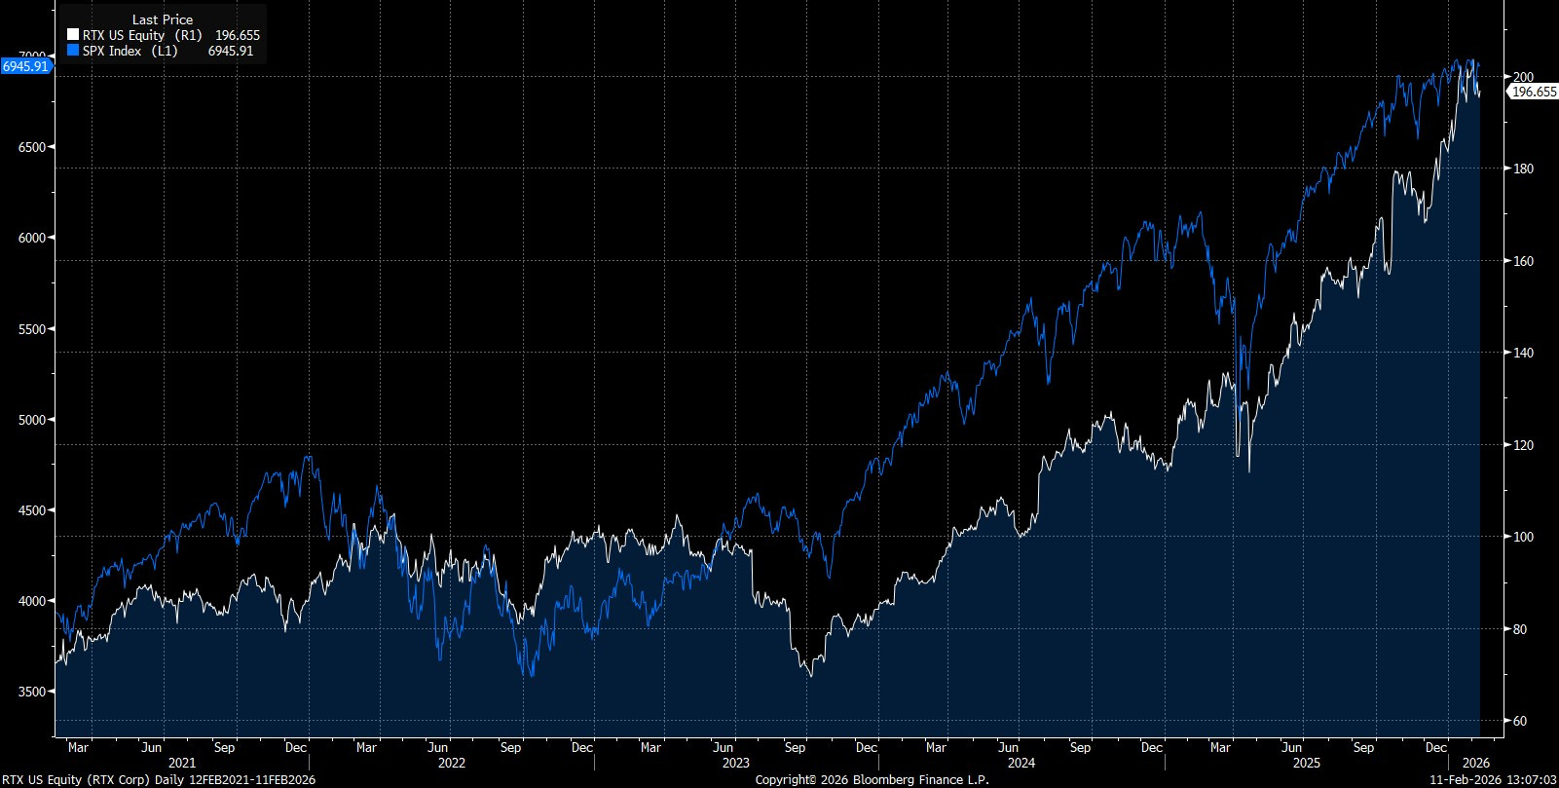
RTX VS. S&P 500
Notes:
In the past year its closed the gap with the S&P. Important to note this industry is very reactive to deals – deals are binary you get them or you don’t.

Slide 8
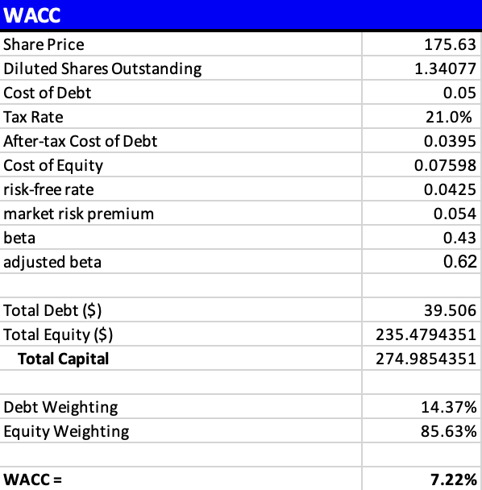
DCF – WACC Assumptions
Industry standard is 7-8%
Low raw beta because of locked in revenue

Slide 9
DCF – Major Assumptions
Capital expenditures grow from $2.0B in 2021 to a projected $4.7B by 2030 (3.8% forecasted growth)
Inventories nearly triple from $9.4B to $23.4B from 2021 to 2030
Accounts payable more than doubles from $21B to $44.9B
Capex, Inventories, and Accounts payable → % of revenue
Bottom line:
RTX is in active production ramp mode absorbing significant capital upfront.
Tax rate rate 21%
3.5% Long term growth rate
Revenue Growth: 7.79% EBIT Margin: 9.31% both found with geometric average
Notes:
Rising inventories plus rising capex plus rising payables all tell the same story — RTX is in active production ramp mode. The balance sheet is absorbing significant working capital to fund that ramp. Rising inventory reflects RTX’s production map you need to buy the materials and build components before shipping off the Patriot missles
A 3.5% long term growth rate reflects the blended structural growth of both end markets rather than anchoring purely to U.S. GDP which would understate RTX's international exposure and the permanent upward reset in defense budgets we're currently witnessing globally.”
The 3.8% capex forecast is geomean of historical data. I decided to use empirical data instead of speculative assumptions
when in doubt I default to what the company has actually demonstrated rather than what I think should happen

Slide 10
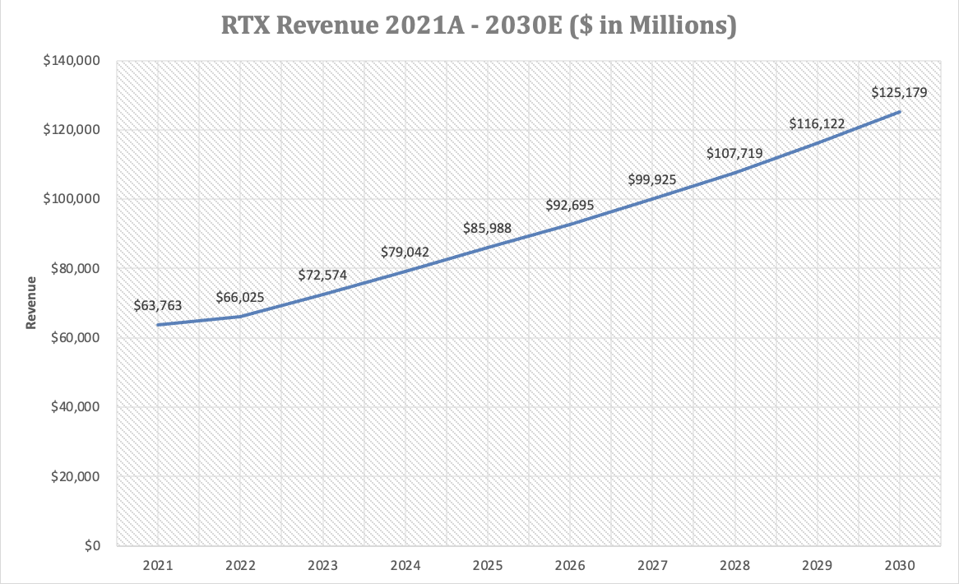
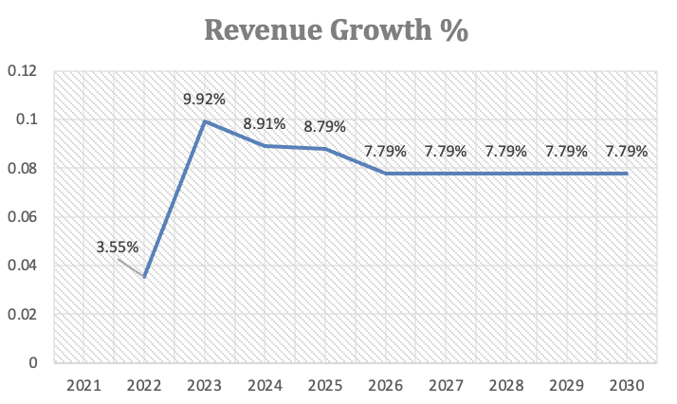
Revenue/Revenue Growth
Notes:
As I mentioned previously mentioned, RTX relies on contracts and backlogs. Because of this RTX’s future revenue is pretty much set in stone. Roughly 85% of Raytheon’s 2026 sales were booked early this year. For my revenue growth assumption I did the geometric mean of the past the past five years. And then I also double checked and made sure that my assumptions were close to the predicted sales reported by RTX.
Note that the revenue growth jumps from 3.55% to 9.92% this was due to a contaminated metal crisis with the manufacture of GTF engines which is a part of the Pratt & Whitney sector. This caused hundreds of commercial aircrafts to be grounded, and as I previously touched on, RTX makes their revenue through maintenance, so when the aircrafts aren’t being used then its going to affect the aftermarket revenue. 2.8 Billion in cumulative charges
This was a one time event and actually caused RTX to increase their inspection.
Thought it was better to include it than to speculate – makes DCF target price more conservative

Slide 11
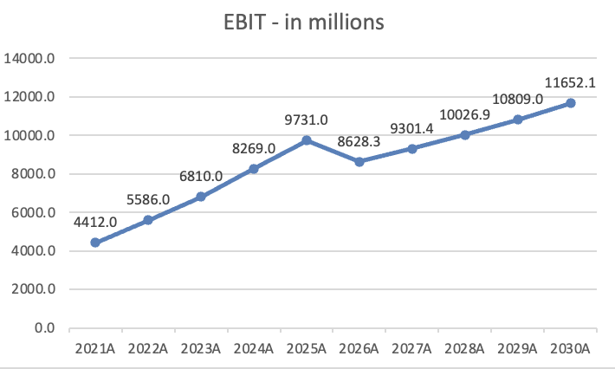
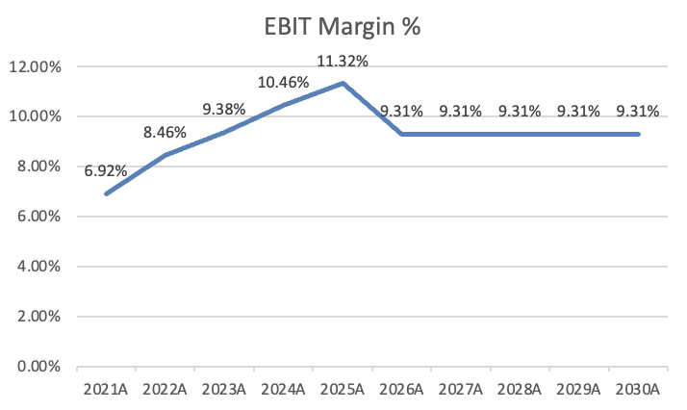
EBIT Margin
Notes:
For my EBIT you can see that for my first forecasted year there’s a dip and then after that a steady incline, this is because I took the geometric mean of the past five years. This included the Powder crisis so this is going to make my sensitivity analysis more conservative.

Slide 12
Sensitivity Analysis
ST Growth
EBIT
Notes:
Must remember RTX’s backlog anchor in on the 7.79%. Then we just focus on the EBIT margin. Our base case was 9.31% but this was conservative when considering the manufacturing crisis.
The headwinds will resolve in the next 12 months. The powder metal compensation payments end by late 2026. That will be $700 million in charges paid out that will stop paying out to airlines. That money goes straight to profit – no new revenue or customers needed.
Pratt’s GTF aftermarket just began so every year those 15,000 engines will need to be serviced.

Slide 13
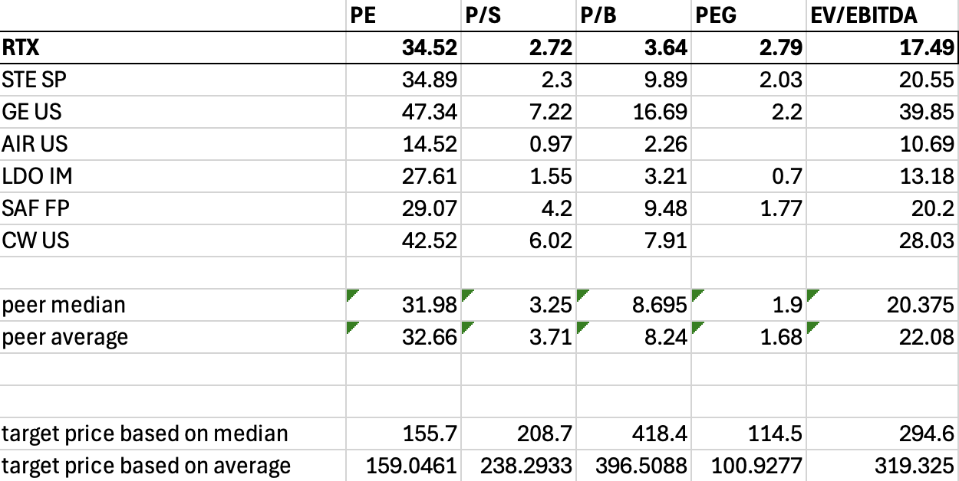
Relative Valuation
Notes:
Its difficult to compare RTX with other companies given its diversified portfolio. Got some Global competitors, international aerospace commercial and defense companies. Didn’t include Lockeed and Northrop because they were are pure defense contract companies.
PE/PEG relationship catches the eye but as I said the powder metal charges are eating into the earnings
The Merger Effect
When RTX merged UTC and Raytheon in 2020 it was an all-stock deal worth roughly $121 billion. That transaction created an enormous amount of goodwill and intangible assets on the balance sheet — essentially the premium paid above the book value of Raytheon's hard assets. Goodwill alone on RTX's balance sheet is approximately $50+ billion.
Goodwill inflates book value. A higher book value denominator means a lower P/B ratio even at the same stock price. RTX's book value is artificially large because of the merger accounting, which makes P/B look deceptively low.

Slide 14
Summary
How did I get target price? $201.76
40% from EV/EBITDA – 294.60
60% from DCF – 139.86
More to story
Why Hold?
Diversified revenue streams
Headwinds will resolve
15,000 Pratt engines globally – 19 countries operating Patriot systems
Notes:
Aerospace and defense is capital intensive — EV/EBITDA is the cleaner multiple because it strips out depreciation, amortization, and merger accounting noise that distorts every other metric for RTX
DCF is weighted more heavily at 60% because RTX's $268 billion backlog removes the biggest source of DCF uncertainty — revenue is essentially already known for the next three years, making the model unusually reliable
No peer multiple can fully capture what RTX is — the only major company in the world that benefits from two completely opposite economic environments simultaneously
Commercial aviation is in full post-COVID recovery while the world is simultaneously in the biggest rearmament wave since the Cold War — both cycles firing at once is historically rare and no comparable company is positioned to capture both
Important to hold a defense company, even if Iran and US deescalate, RTX is still diversified

Slide 15
Thank You

